Slide 1
Binary Codes
Electronic digital systems use signals that have two distinct values (0 and 1) and circuit elements that have two stable states (ON and OFF).
Digital systems represent and manipulate binary numbers, as well as other discrete elements of information using binary codes.
A binary code is just an assignment of numeric values to bit patterns. Binary codes merely change the symbols, but not the meaning of the elements of information that they represent.
To represent a group of 2^{n} distinct elements in a binary code requires a minimum of n bits.
There is no maximum number of bits that may be used for a binary code.

Slide 2
Binary Codes
Binary Codes for Decimal Digits
BCD
2421
Excess 3
8, 4, -2, -1
Gray Code
Character Code
ASCII
Error Detection Codes
Even parity
Odd Parity

Slide 3
Binary Codes for Decimal Numbers

Slide 4
Binary Codes for Decimal Numbers
The usual interpretation of a binary number is as defined according to the definition of a number in in base-2 system.
There are, however, alternate methods used to encode numeric data into binary bit patterns.
Note: All upcoming tables present binary codes and not binary numbers.

Slide 5
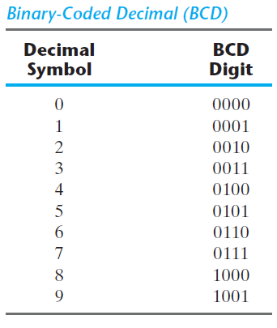
1. Binary Coded Decimal (BCD)
Refers to Binary Coded Decimal
BCD number is just a natural binary encoding of the decimal digits from 0 to 9 on four bits.
Therefore a string of bits is grouped into groups of four bits, and interpreted as a string of decimal digits.
Takes more space to represent binary numbers but its easily understandable
Similar to Hex, but it stops at 9. Hence, 6 combinations are wasted.
E.g. 15₁₀ = 1111₂ in binary and 15₁₀ = 0001 0101 in BCD
BCD is often used in digital voltmeters, frequency convertors, digital clocks and calculators
Notes:
A number with k decimal digits will require 4k bits in BCD. E.g. 396 can be represented in 3*4=12 bits
If you are given 2 digits, maximum decimal number that can be represented in BCD is 99 i.e. all 1111 1111 in BCD

Slide 6
1. Binary Coded Decimal (BCD)
Binary-Coded Decimal is a weighted code because each decimal digit can be obtained from its code word by assigning a fixed weight to each code-word bit.
BCD is also called as the 8421 code, owing to the weights of the BCD bits
Two BCD digits are added as binary numbers
However, when binary sum is more than decimal 9 or binary (1001)₂, the result is invalid (since last 6 combinations have no meaning in BCD)
Addition of 6₁₀=(0110)₂ make a correct BCD and produces a carry

Slide 7
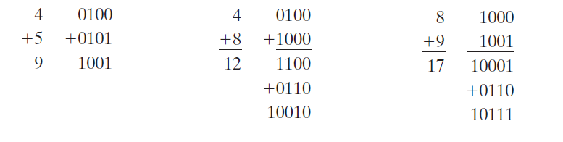
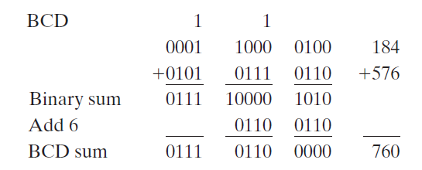
BCD Addition
Consider the multibit addition of 184 + 576 = 760 in BCD:
Notes:
BCD adders require significantly more hardware and no longer have a speed advantage of conventional binary adders

Slide 8
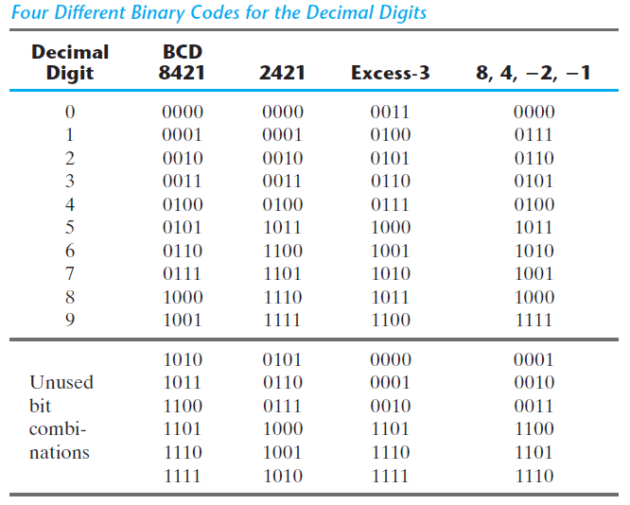
2. The 2421 Code
2421 code is a weighted code.
Some digits in 2421 code can be coded in two possible ways. E.g. 4₁₀ can be written as 0100 or 1010, since both combinations add up to a total weight of 4.
2421 code is self-complementing, i.e. 9’s complement of decimal digital x is simple bit inversion of its 2421 code.
E.g. Find 9’s complement of 2₁₀
2₁₀ = 0010 in 2421 scheme
hence 9’s complement = 1101 i.e. 7 in decimal

Slide 9
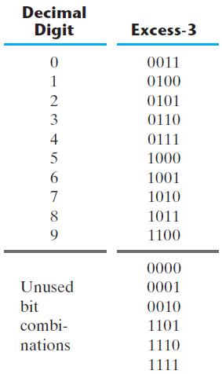
3. Excess 3 Code
In Excess-3 code, each coded combination is obtained from the corresponding binary value plus 3.
Like 2421, the excess‐3 codes is also a self‐complementing code ➔ i.e 9’s Comp of decimal number is simple bit inversion of excess 3 code
Decimal 395 is represented in the excess‐3 code as 0110 1100 1000. The 9’s complement of 395 is obtained by complementing each bit of the code, hence getting 1001 0011 0111, which is 604₁₀

Slide 10
4. The 8,4,-2,-1 Code
The 8, 4, -2, -1 code is an example of assigning both positive and negative weights to a decimal code.
Notes:
Practice Question: What decimal value does 1100001111001001 represent in different binary codes?

Slide 11
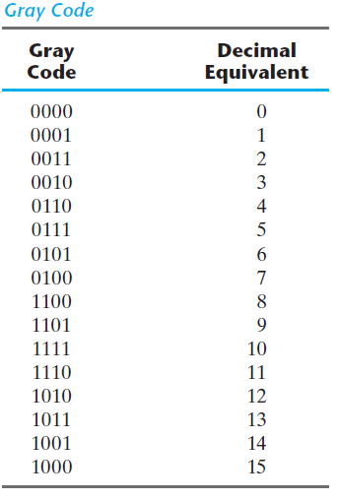
5. Gray Code
A code where only one bit changes at a time while traversing from 0 to any decimal number in sequence.
The Gray code is used in applications in which the normal sequence of binary numbers generated by the hardware may produce an error or ambiguity during the transition from one number to the next.
Why is this useful?
0111➔1000 (All Four bits need to be changed)
Notes:
This is a useful property when converting analog values into digital values, since it eliminates the problem of misinterpreting asynchronous changes to bits between valid values.

Slide 12
Character Codes
Many applications require handling of not only numbers but letters and special characters

Slide 13
1. ASCII
ASCII refers to American Standard Code for Information Interchange
ASCII represents each character with a 7-bit string, yielding a total of 128 characters.
94 are graphic characters that can be printed. The graphic characters consist of the 26 uppercase letters (A through Z), the 26 lowercase letters (a through z), the 10 numerals (0 through 9), and 32 special printable characters, such as %, *, and $.
34 nonprinting characters used for various control functions like arranging the printed text into a prescribed format. Examples include Backspace, Tab, Shift, Space, Escape, Delete, etc
This encoding system not only lets a computer store a document as a series of numbers, but also lets it share such documents with other computers that use the ASCII system.

Slide 14
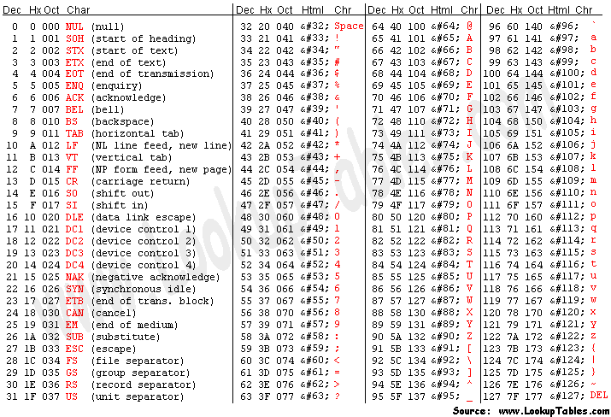
Notes:
*Not to be crammed.

Slide 15
Other Character Codes
EBCDIC (Extended Binary Coded Decimal Interchange Code) uses 8 bits;
used by IBM mainframes. It is an extension of BCD code.
Unicode uses 16bits;
Windows NT supports Unicode.

Slide 16
Error Detection Codes
An error in a digital system is the corruption of data from its correct value to some other value. i.e., a change of some bits from 0 to 1 or vice versa.

Slide 17
Error Detection Codes
To detect errors in data communication and processing, an eighth bit is sometimes added to the ASCII character to indicate its parity. A parity bit is an extra bit included with a message to make the total number of 1’s either even or odd.
Even parity – set bit to make total number of 1’s even (More Common)
A (1000001) with even parity is 01000001
C (1000011) with even parity is 11000011
Odd parity: set bit to make total number of 1’s odd
A (1000001) with odd parity is 11000001
C (1000011) with odd parity is 01000011
Note that parity detects only simple errors e.g. if one, three bits are flipped.

Slide 18
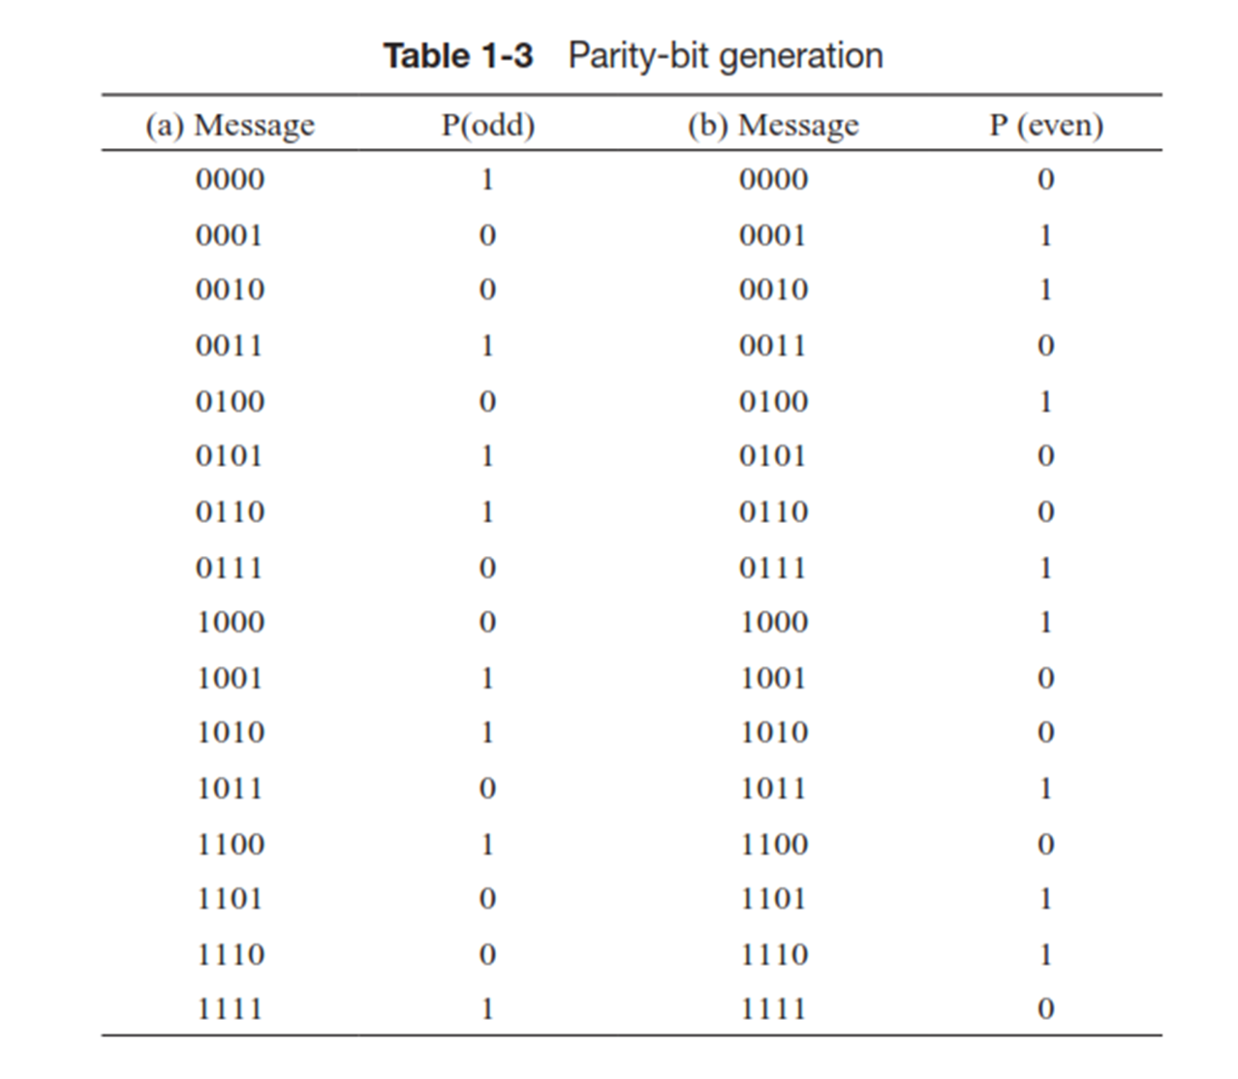
Parity Bit Generation

Slide 19
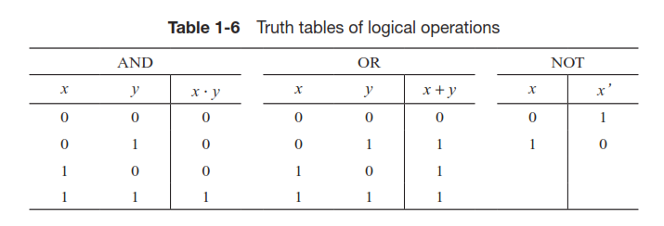
Binary Logic
It consists of binary variables and logical operations.
AND (multiply)
OR (add)
Not (Compliment)

Slide 20
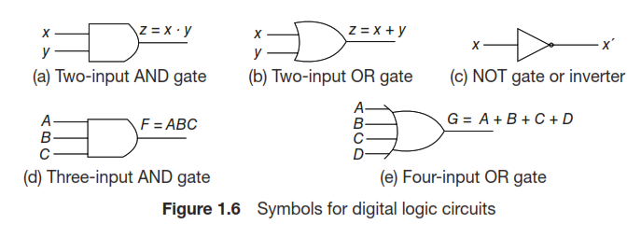
Logic Gates

